Slide 1

PRESENTATION TO THE ELECTROTECHNICAL INDUSTRY
16 February 2023

Slide 2

PRESENTATION OUTLINE
Overview of the NRCS
1.1 Regulatory supervision approach
1.2 Cost drivers
2. Some success stories
3. Challenges

Slide 3
1. OVERVIEW OF THE NRCS

Slide 4
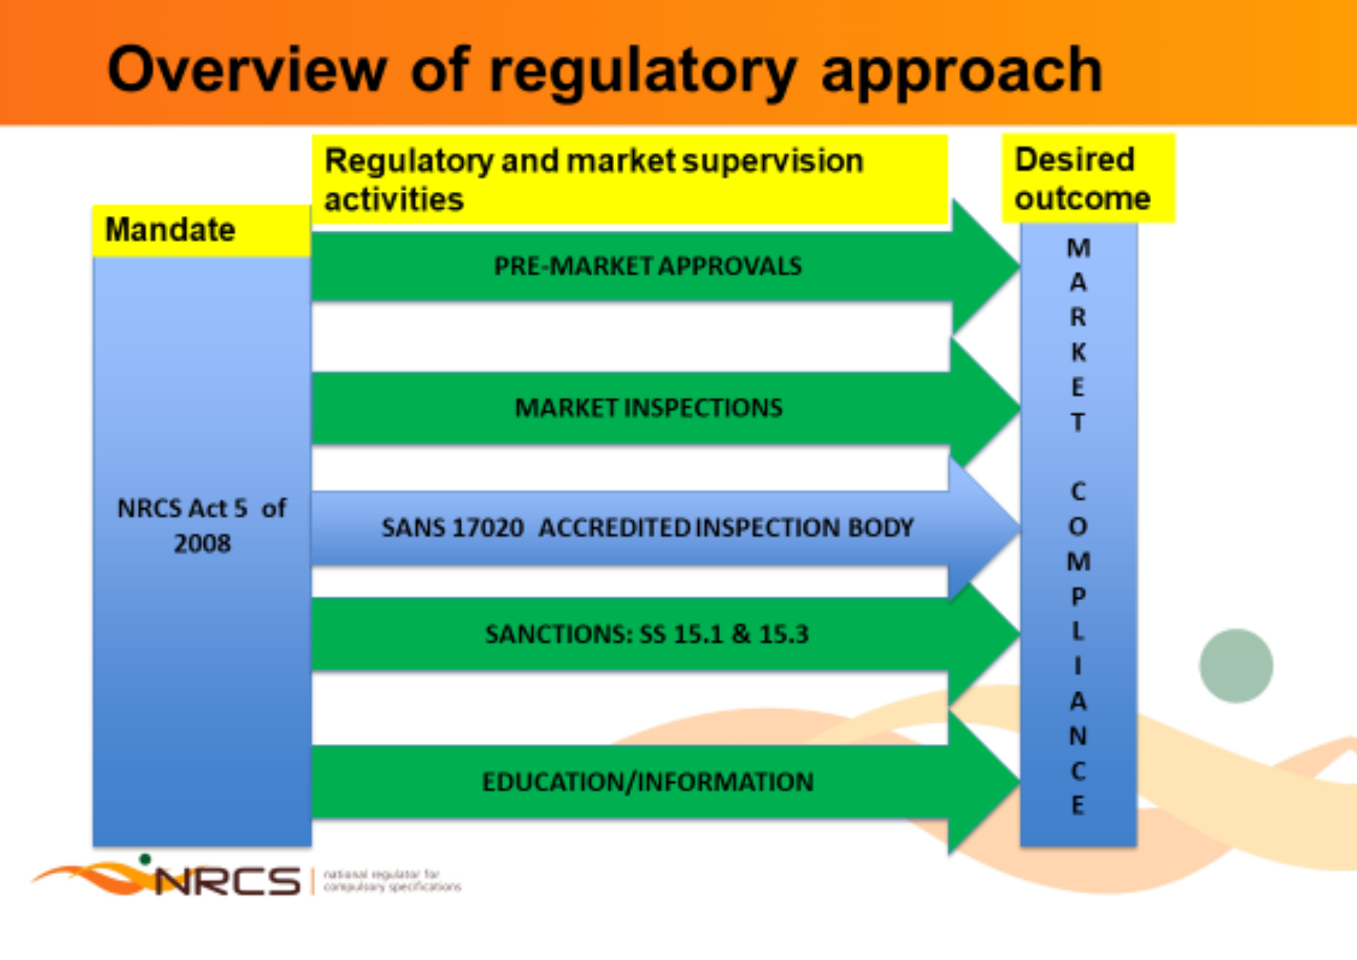
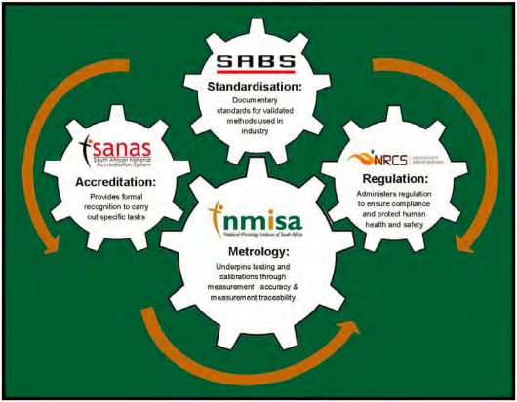
Regulatory supervision approach
Quality infrastructure lattice
Technical infrastructure: system of interrelated mandates with reciprocal and pooled interdependencies.
Risk based approach
Inspection at source: 60-70% at source, 30-40% at retail space

Slide 5
Overview of Electrotech cost drivers
Overheard costs
(Traveling, consumables, supervision, licenses, casual labour, support functions, etc.)
Direct costs
Activity cost pools
Approvals
Inspections
Sanctions
Main cost drivers
Volume of applications
Market size
Volume of non-compliant products
Turnaround times
Rework corrections
No. of Inspectors
No of inspections/sites
No of samples/tests
No of inspectors
Testing capacity and cost
Travelling & Accommodation
Cost
No of products destroyed
Transport, storage, cost
Services rendered by NRCS

Slide 6
2. SOME SUCCESS STORIES

Slide 7
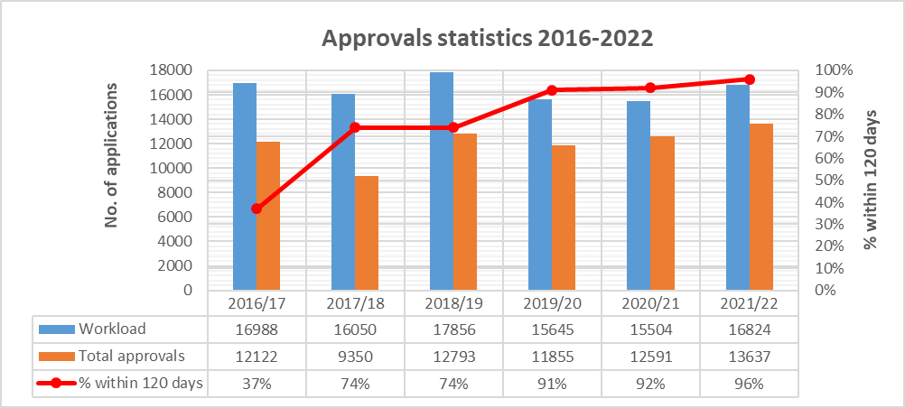
2.1. Continuous improvement in LOA turnaround times
37% in 2016/17 to 96% in 2021/22
~73 000 LOAs issued in period
~5% of the applications are closed/rejected
Target of 120 days – BU close to target (-4%)

Slide 8
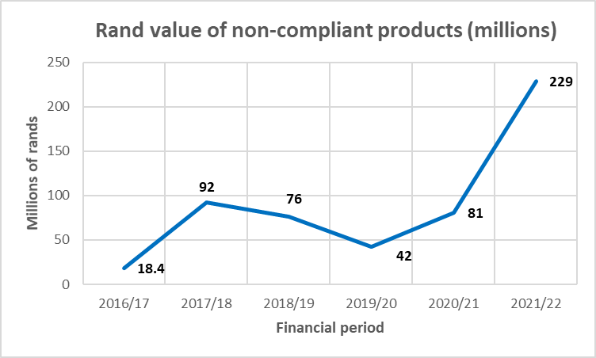
2.2 Continued eradication of non-compliant products
~0.5 billion rands worth of non-compliant products found on the market from 2016/17 to 2021/22
Products included incandescent lamps, compact fluorescent lamps, chargers, sewing machines, ICLs, power banks, LED panels, inverters, electric cookers, heat exchangers, adapters, lamp holders, plastic bucket water heaters, sewing machines, cash registers, hand dryers, vacuum cleaners, power tools, toasters, adult toys and reconditioned geysers

Slide 9
2.3 Implementation of EE database from 1 April 2021
THREE PORTALS
1. REGULATOR
2. APPLICANT
3. PUBLIC
Evaluate evidence of conformity
Make and communicate regulatory decisions
Submit applications for LOAs and required documentation
Check if a specific product has been approved by the regulator and its energy efficiency ratings
Web based, running on Drupal platform, with maintenance and technical support service provider
Turnaround times average ~60 days (with large % issued within 30 days) compared to above 120 days in 2016/17

Slide 10
Key benefits of the EE Database system
REGULATOR
Reduces the amount of work required of Regulator Staff
Reduces the number of returned applications
Reduces the turn around time for applications
Automated email notification of any change in status
Applications validated by the system
APPLICANTS
Central Record of All Applications submitted through the system
Automated notifications via email of a change in the status of
applications (Submitted, Pending, Evaluated, Closed)
Ability to check the status of an application at any time
Download LOA

Slide 11
3.3 Stakeholder engagements
Engagement and move to recognize Agents/Consultants
Move to establish Specialist Consultative Committee (SCC)

Slide 12
3. CHALLENGES

Slide 13
3.1 Approvals challenges
Volume of applications vis a vis number of available Approvals inspectors
Inadequate administrator/coordinator capacity
Non payment of levies delays applications, thus, impacting on turnaround times
Delays by applicants in making corrective actions on the findings raised
Processes for safety LOA applications are largely manually paced and require a lot of administrative and paper handling effort

Slide 14
3.1 Market surveillance challenges
Constrained human capital capacity (20 market surveillance inspectors to cover the whole country)
Limited sampling and testing
Timely gazetting of new VCs and amendments (e.g. VC 8055)
Storage capacity for confiscated products
Volumes of non-compliant products still high

Slide 15
The End

